Slide 1
CS4473/5473: Parallel, Distributed, and Network Programming (PDN)
Dr. Richard Veras
SIMD (AVX) and ILP
Joy Mosisa

Slide 2
PG Instructions
This assignment has two parts. First, you will work through, describe and analyze a variety of short vector instructions (Single Instruction Multiple Data [SIMD]). Second, you will use these instructions to implement a variety of higher-level functions and analyze those code sequences.
Examples of SIMD and analyzing their behavior. You will run the code in "./0_examples" and work through the "STUDENT_TODOs".
For each example Analyze the osaca report for each example. note you will run 'make measure-osaca' to get the report. For each code block that you analyze you will uncomment the instrumentation marks ({begin,end}_instrumentation) for the block in question and comment out all other marks.
For this pg assignment you will ("./2_assignment"):
Diagram your sequence of SIMD instructions before coding them (this will save you many hours of coding if you do this first)
Additionally, you will include a screenshot of the OSACA analysis for the scalar (reference) code and your vectorized (student todo) code. Fill out the template questions and make a note of your observations.
You are encouraged to use this template, but you are welcome to use your own tool of choice (even pen and paper) to illustrate the examples.
Feel free to resize these slides: https://support.microsoft.com/en-us/office/change-the-size-of-your-slides-040a811c-be43-40b9-8d04-0de5ed79987e

Slide 3
PG Notes
NOTE: You can use any instructions from:
https://software.intel.com/sites/landingpage/IntrinsicsGuide/#techs=SSE4_1,AVX,AVX2
But, I strongly suggest the following instructions:
__m256 _mm256_loadu_ps (float const * mem_addr) // Load
void _mm256_storeu_ps (float * mem_addr, __m256 a) // Store
__m256 _mm256_set1_ps (float a) // set
__m128 _mm256_extractf128_ps (__m256 a, const int imm8) // extract
int _mm_extract_ps (__m128 a, const int imm8) // SSE 4.1
__m256 _mm256_permute_ps (__m256 a, int imm8) // w/in lane // permute with one input
__m256 _mm256_permutevar8x32_ps (__m256 a, __m256i idx) // across lane
__m256 _mm256_blend_ps (__m256 a, __m256 b, const int imm8) // Blend
__m256 _mm256_shuffle_ps (__m256 a, __m256 b, const int imm8) // Shuffle with two inputs
__m256 _mm256_fmadd_ps (__m256 a, __m256 b, __m256 c) // Math

Slide 4
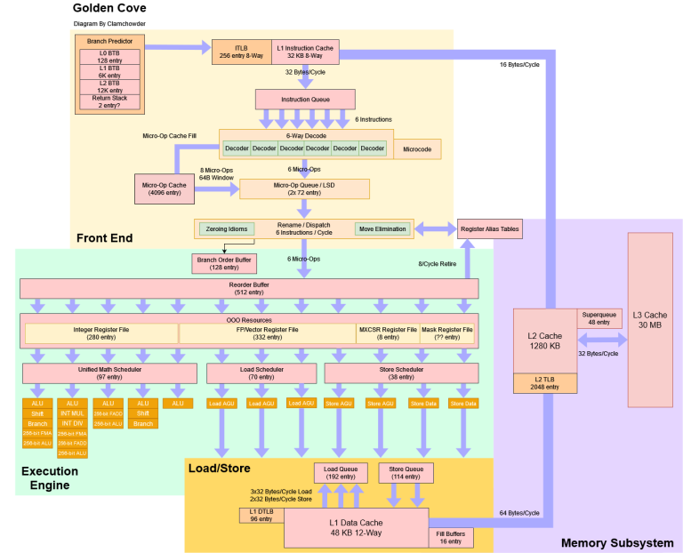
Context: Measuring ILP with OSACA
Modern CPU microarchitectures are really complex (see https://chipsandcheese.com/p/popping-the-hood-on-golden-cove). The process is as follows for each clock cycle
[Front end] Several instructions are fetched from memory.
[Front end] Those instructions are decoded into microoperations.
[Execution Engine] Those microoperations are queued in a buffer.
[EE] When those microoperations have their dependencies resolved and a resource (port) is available they are dispatched to that resource (port).
[EE] if a microoperation is completed on a port (these are pipelined so we will have multiple microops in flight) then its result is either written to a register or sent to the Load/Store Engine.
A lot of this complexity exists to exploit as much instruction level parallelism out of the code as possible. However, we have to extract that parallelism

Slide 5
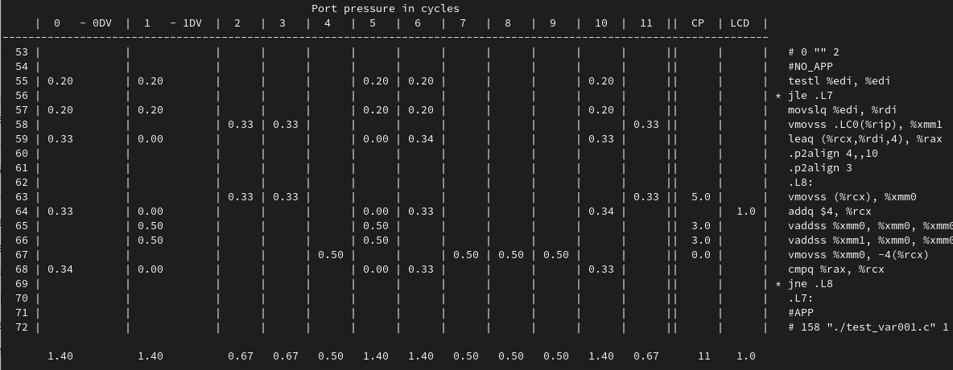
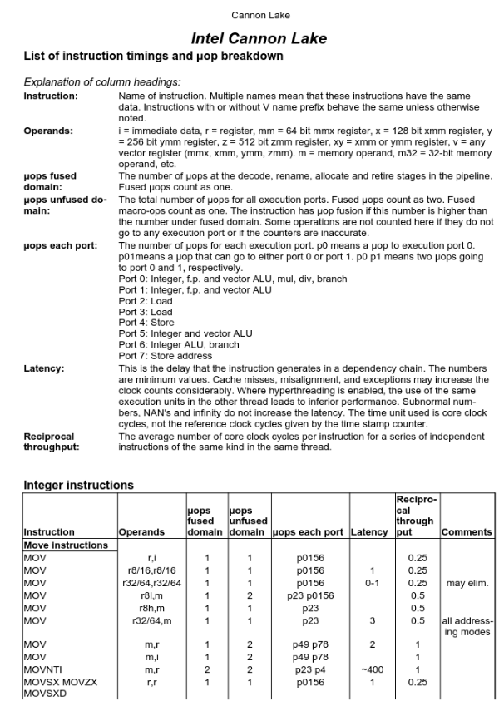
Context: Measuring ILP with OSACA
OSACA is mirroring the microarchitecture (CPU) and simulating the execution of the code. We can do this by hand, we just need to know:
Which port each instruction can go to (resources and reciprocal throughput).
How long each instruction takes (latency).
The Agner Fog Instruction Tables list this:
https://www.agner.org/optimize/instruction_tables.pdf

Slide 6
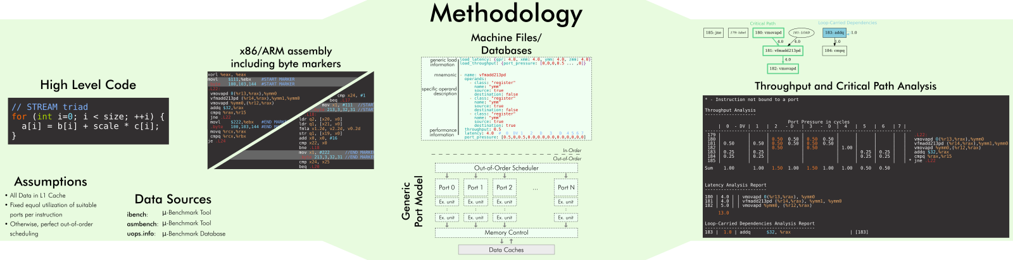
OSACA
OSACA is a cycle accurate simulator for estimating the performance of looped code. (https://github.com/RRZE-HPC/OSACA).
We will use this tool to develop a deeper understand of Instruction Level Parallelism (ILP) while we exploit SIMD parallelism.
Prior to tools like OSACA one would estimate loop throughput using instruction tables (https://www.agner.org/optimize/instruction_tables.pdf )

Slide 7
Problems

Slide 8
./0_example
Run 'make' to see all the STUDENT_TODOs
Run 'make test' to run the verifier. For each problem:
Diagram the SIMD sequence that transforms the input to the desired output.
Implement the student variant of the code to match the reference using only SIMD instructions.
Run 'make measure-osaca' to simulate the performance of the instruction sequences.
For both implementations take a screenshot of the report and fill out the template questions.

Slide 9
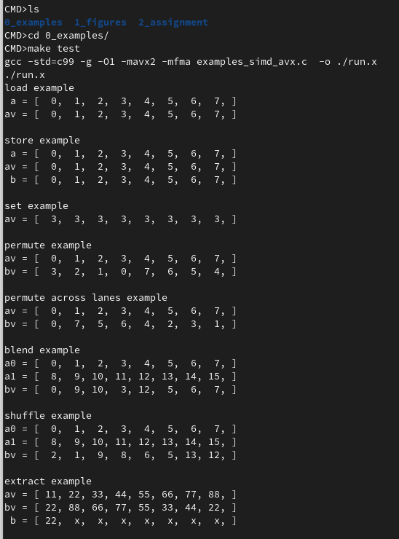
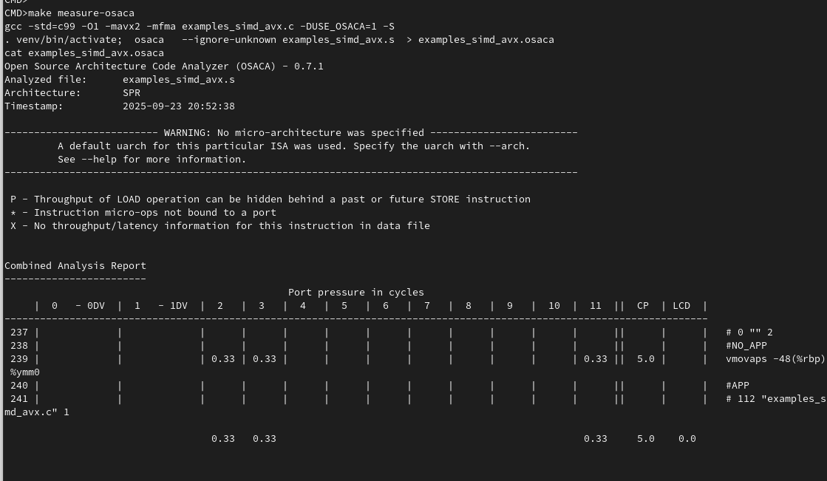
./0_example

Slide 10
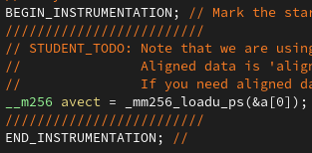
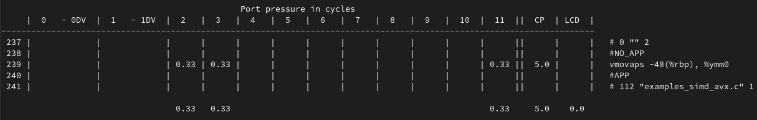
Load example: OSACA
Instrumented Reference Code
_mm256_loadu_ps copies 8 floats from memory into a vector
The iteration is translated into 1 assembly instruction "vmovaps mem, reg"
The latency (critical path [CP]) is 5 cycles.
There are no (0.0) Loop Caried Dependencies (LCD)
The bottleneck (max cycles) is on ports 2,3 and 11 for 0.33 cycles
An iteration of this loop will complete every .33 cycles (max of LCD and bottleneck).
In a loop this processor can complete 1/0.33= 3 loads every cycle.
OSACA Report

Slide 11
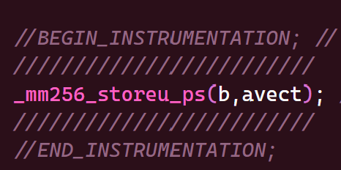
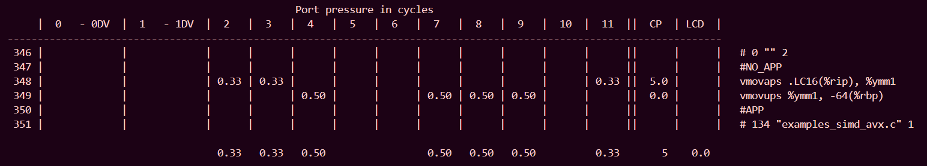
Store example: OSACA
Instrumented Reference Code
Store into memory
vmovups m256, ymm
5 cycles
No
Bottleneck -> Ports – Max Cycles: 4 – 0.5, 7 – 0.5, 8 – 0.5, and 9 – 0.5
0.5 cycles
1/0.5 = 2 loads every cycles
ADD SNIPPET
OSACA Report

Slide 12
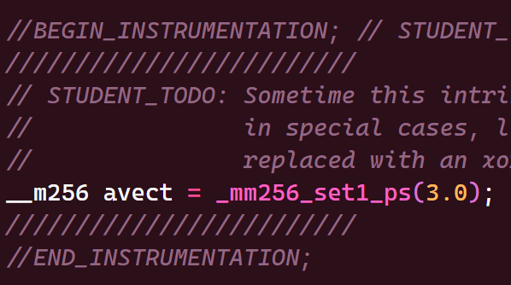
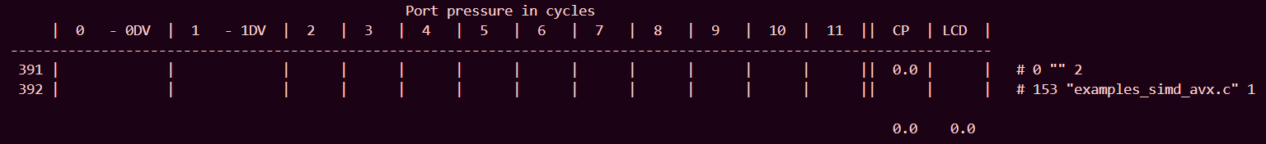
Set example: OSACA
Instrumented Reference Code
Broadcast single-precision (32-bit) floating-point value to all elements.
Sequence
0 cycles
No
Bottleneck -> None
0 cycles
0 loads every cycle
ADD SNIPPET
OSACA Report

Slide 13
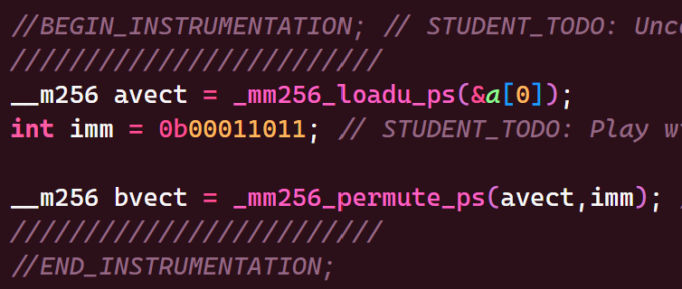
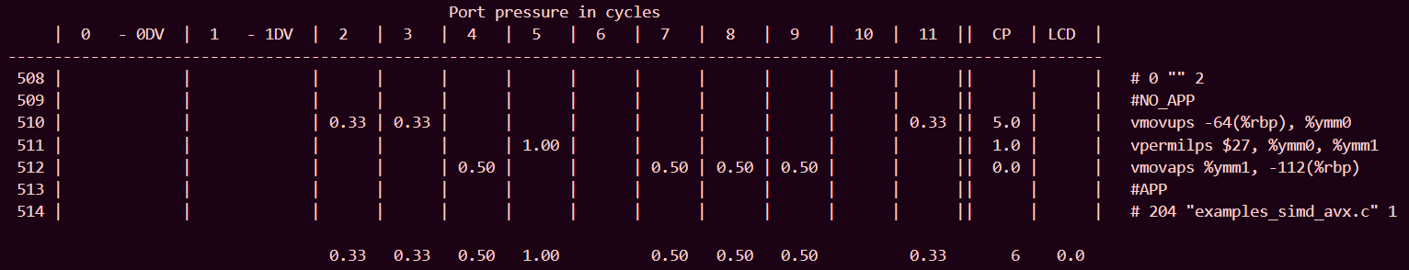
Permute example: OSACA
Instrumented Reference Code
Shuffle single-precision (32-bit) floating-point elements in a within 128-bit lanes using the control in imm8, and store the results.
vpermilps ymm, ymm, imm8
6 cycles
No
Bottleneck -> Ports – Max Cycles: 5 – 1
1 cycle
1/1 = 1 load every cycle
ADD SNIPPET
OSACA Report

Slide 14
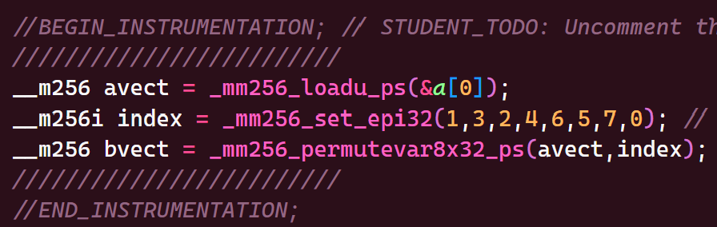
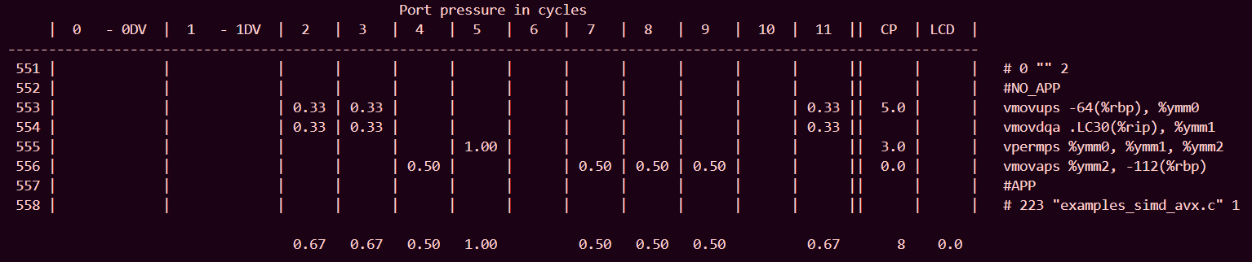
Permute across lanes example: OSACA
Instrumented Reference Code
Shuffle single-precision (32-bit) floating-point elements in a across lanes using the corresponding index.
vpermps ymm, ymm, ymm
8 cycles
No
Bottleneck -> Ports – Max Cycles: 5 – 1
1 cycle
1/1 = 1 load every cycle
ADD SNIPPET
OSACA Report

Slide 15
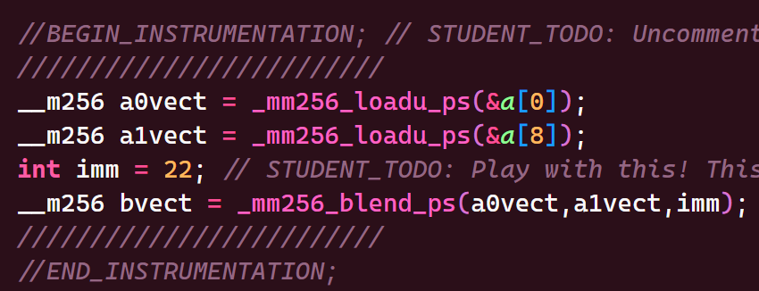
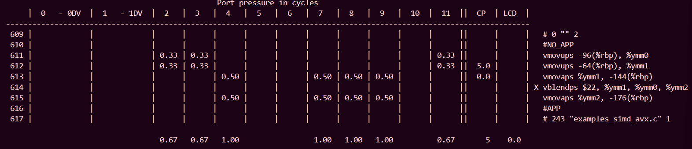
Blend example: OSACA
Instrumented Reference Code
Blend packed single-precision (32-bit) floating-point elements from a and b using control mask imm8, and store the results.
vblendps ymm, ymm, ymm, imm8
5 cycles
No
Bottleneck -> Ports – Max Cycles: 4 – 1, 7 – 1, 8 – 1, and 9 – 1
1 cycle
1/1 = 1 load every cycle
ADD SNIPPET
OSACA Report

Slide 16
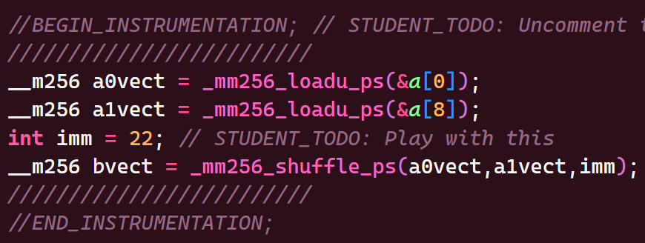
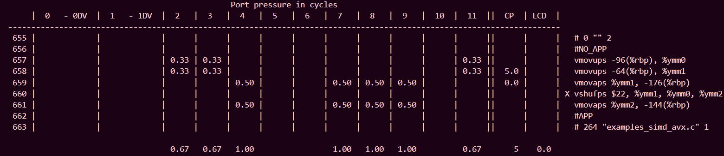
Shuffle example: OSACA
Instrumented Reference Code
Shuffle single-precision (32-bit) floating-point elements in a within 128-bit lanes using the control in imm8, and store the results.
vshufps ymm, ymm, ymm, imm8
5 cycles
No
Bottleneck -> Ports – Max Cycles: 4 – 1, 7 – 1, 8 – 1, and 9 – 1
1 cycle
1/1 = 1 load every cycle
ADD SNIPPET
OSACA Report

Slide 17
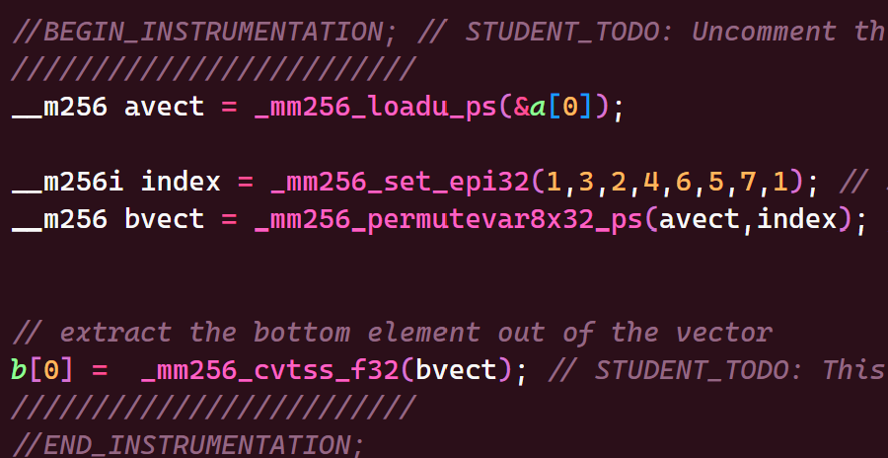
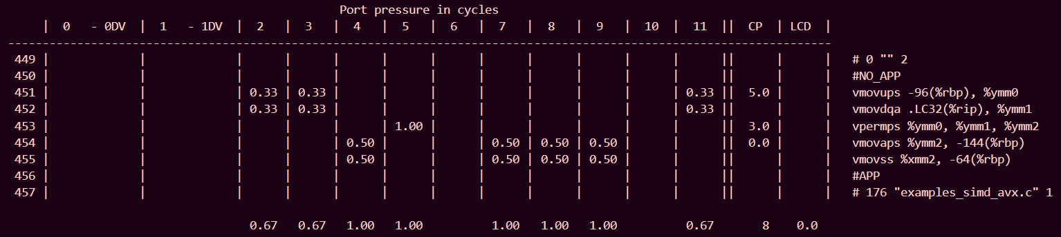
Extract example: OSACA
Instrumented Reference Code
Copy the lower single-precision (32-bit) floating-point element.
vmovss m32, xmm
8 cycles
No
Bottleneck -> Ports – Max Cycles: 4 – 1, 5 – 1, 7 – 1, 8 – 1, and 9 – 1
1 cycle
1/1 = 1 load every cycle
ADD SNIPPET
OSACA Report

Slide 18
./2_assignment
Run 'make' to see all the STUDENT_TODOs
Run 'make test' to run the verifier. For each problem:
Diagram the SIMD sequence that transforms the input to the desired output.
Implement the student variant of the code to match the reference using only SIMD instructions.
Run 'make measure-osaca' to simulate the code performance for the reference and your implementation.
For both implementations take a screenshot of the report and fill out the template questions.

Slide 19
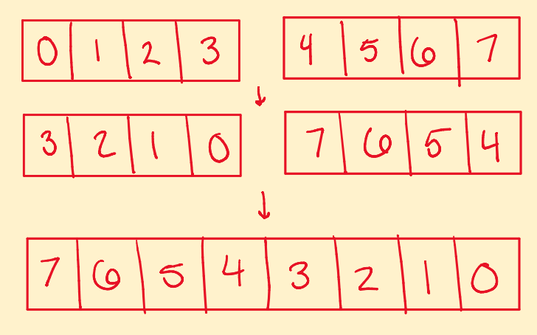
01: test_reverse_8xfloat
v
0
1
2
3
4
5
6
7
v
0
1
2
3
4
5
6
7
Input (a)
Output (b)
0
0
1
1
2
2
3
3
4
4
5
5
6
6
7
7

Slide 20
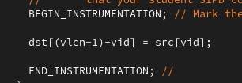
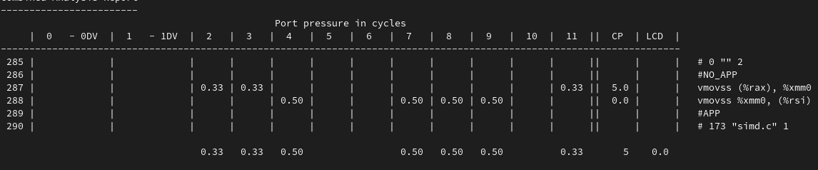
01: test_reverse_8xfloat: OSACA reference
Instrumented Reference Code
Each iteration copies one element of src to its reversed location in dst.
The iteration is translated into 2 assembly instructions (vmovss) for loading and storing.
The critical path, or time it takes a specific iteration to complete, is 5 cycles.
There are no (0.0) Loop Caried Dependencies (LCD)
The bottleneck (max cycles) is on ports 4,7,8 and 9 for 0.5 cycles
An iteration of this loop will complete every .5 cycles (max of LCD and bottleneck).
Or, this loop can complete 1/0.5= 2 iterations of 'reverse' every cycle.
OSACA Report

Slide 21
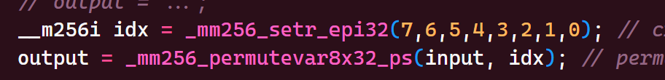
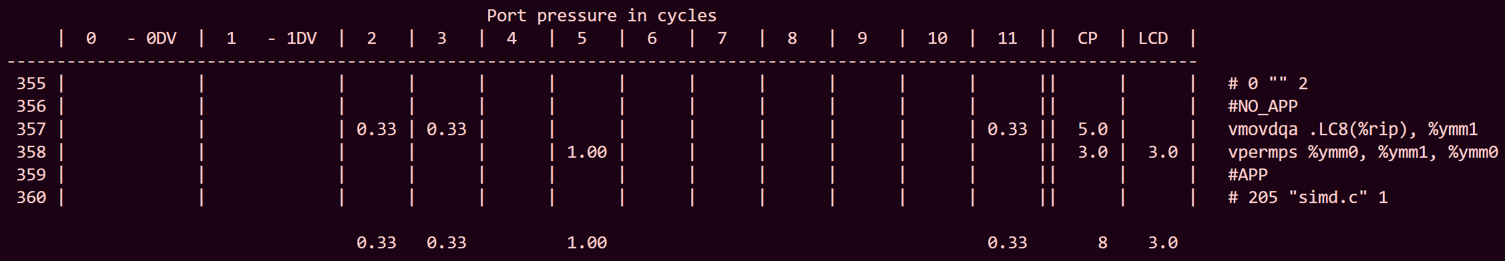
01: test_reverse_8xfloat: OSACA student
Instrumented Student Code
Each operation reorders all 8 elements of src to their reversed locations in dst.
The iteration is translated into 2 assembly instructions: vmovdqa and vpermps.
Critical path is 8 cycles.
There is a 3 cycle LCD.
The bottleneck is on ports 5 for 1 cycle.
An iteration of this loop will complete every 3 cycles.
This loop can complete 1/3 = 0.33 iterations every cycle.
OSACA Report

Slide 22
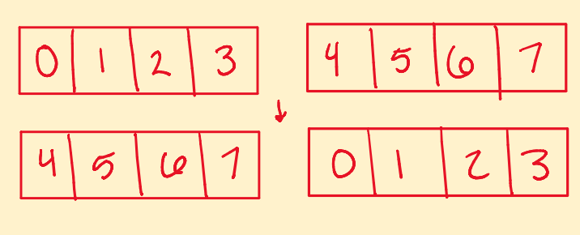
02: test_rotate_by_4_8xfloat:
v
0
1
2
3
4
5
6
7
v
0
1
2
3
4
5
6
7
Input (a)
Output (b)
0
1
2
3
4
5
6
7

Slide 23
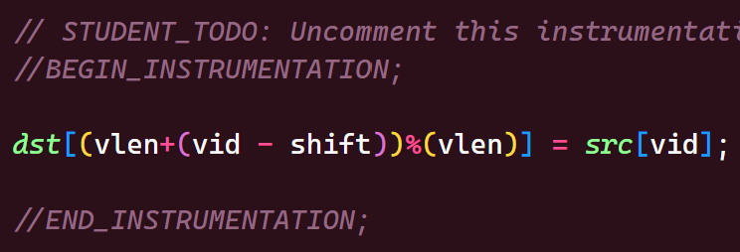
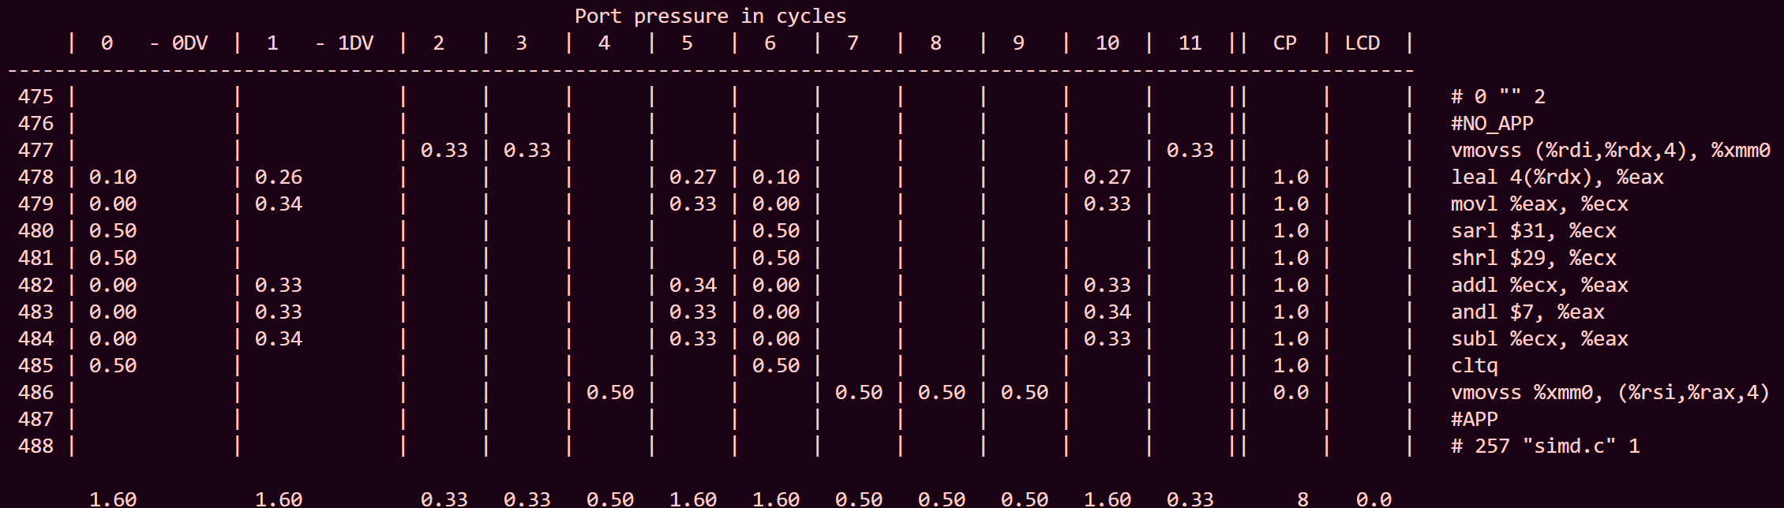
02: test_rotate_by_4_8xfloat: OSACA reference
Instrumented Reference Code
Each iteration copies one element of src to its rotated location in dst, shifted by 4 positions.
The iteration is translated into 10 assembly instructions: vmovss, leal, movl, sarl, shrl, addl, andl, subl, cltq.
Critical path is 8 cycles.
There is no LCD.
The bottleneck is on ports 0, 1, 5, 6, and 10 for 1.6 cycles.
An iteration of this loop will complete every 1.6 cycles.
This loop can complete 1/1.6 = 0.625 iterations every cycle.
OSACA Report

Slide 24
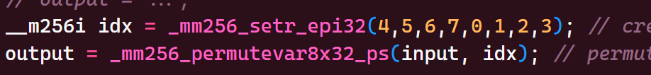
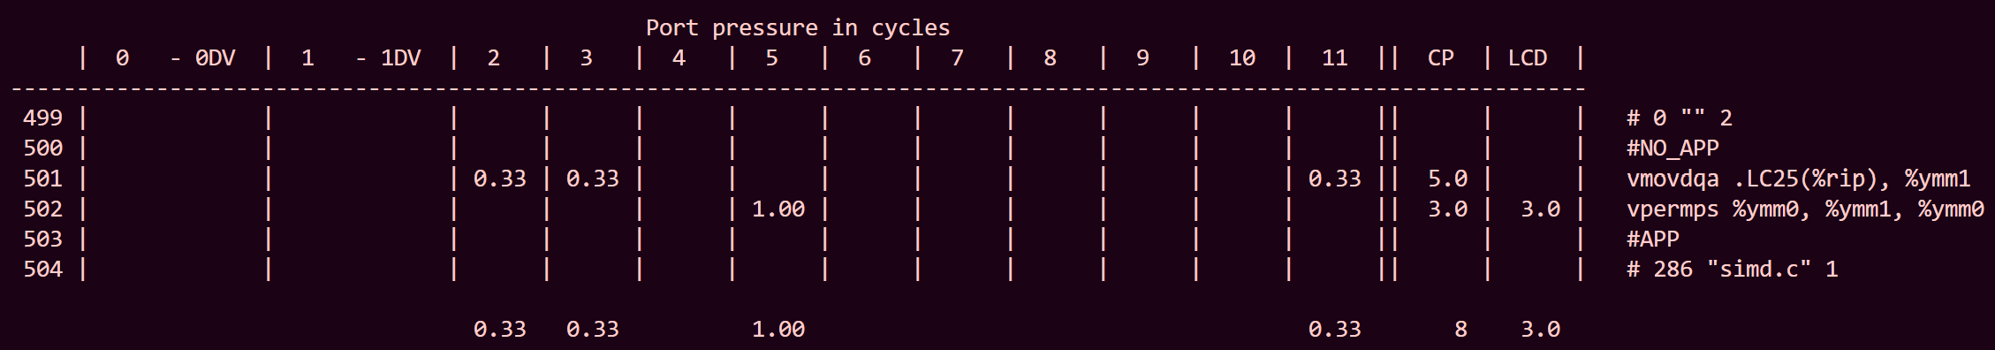
02: test_rotate_by_4_8xfloat: OSACA student
Instrumented Student Code
Each operation rotates all 8 elements of src by 4 positions to their new locations in dst.
The iteration is translated into 2 assembly instructions: vmovdqa, vpermps.
Critical path is 8 cycles.
There is a 3 cycle LCD.
The bottleneck is on port 5, for 1 cycle.
An iteration of this loop will complete every 3 cycles.
This loop can complete 1/3 = 0.33 iterations every cycle.
OSACA Report

Slide 25
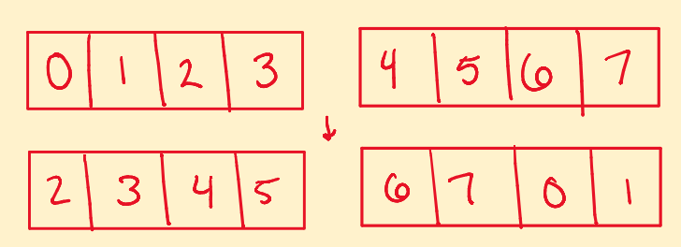
03: test_rotate_by_2_8xfloat:
v
0
1
2
3
4
5
6
7
v
0
1
2
3
4
5
6
7
Input (a)
Output (b)
0
1
2
3
4
5
6
7

Slide 26
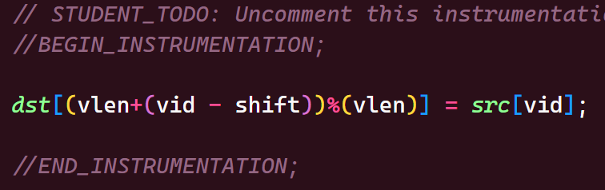
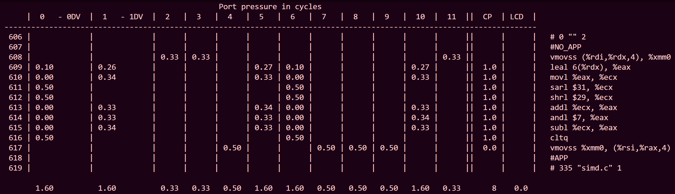
03: test_rotate_by_2_8xfloat: OSACA reference
Instrumented Reference Code
Each iteration copies one element of src to its rotated location in dst, shifted by 2 positions.
The iteration is translated into 10 assembly instructions: vmovss, leal, movl, sarl, shrl, addl, andl, subl, cltq.
Critical path is 8 cycles.
There is no LCD.
The bottleneck is on ports 0, 1, 5, 6, and 10 for 1.6 cycles.
An iteration of this loop will complete every 1.6 cycles.
This loop can complete 1/1.6 = 0.625 iterations every cycle.
OSACA Report

Slide 27
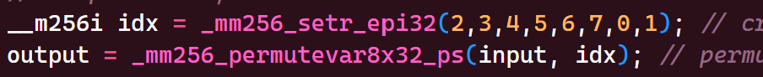
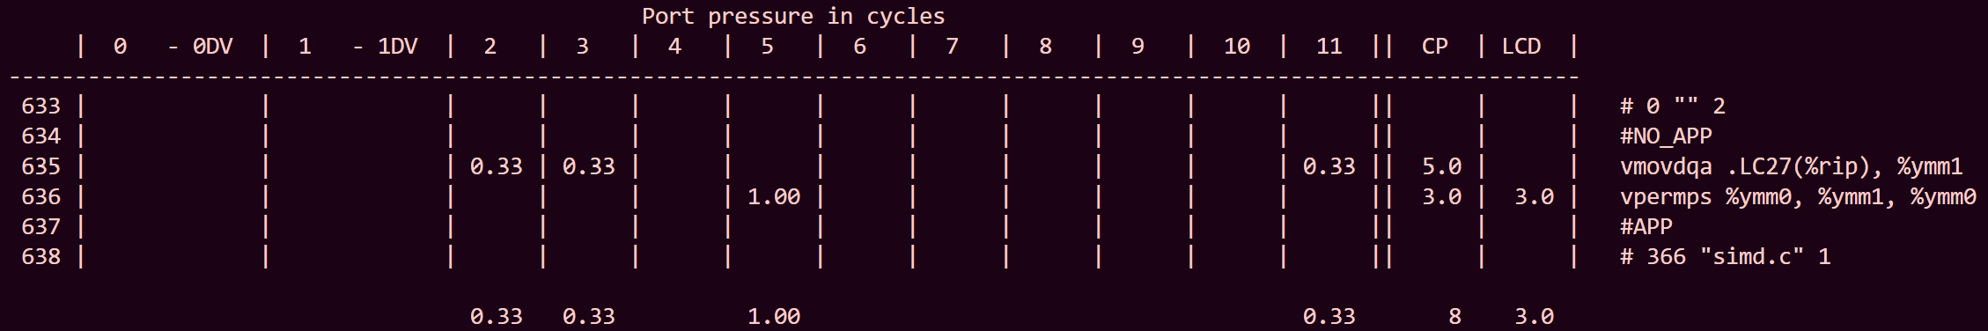
03: test_rotate_by_2_8xfloat: OSACA student
Instrumented Student Code
Each operation rotates all 8 elements of src by 2 positions to their new locations in dst.
The iteration is translated into 2 assembly instructions: vmovdqa, vpermps.
Critical path is 8 cycles.
There is a 3 cycle LCD.
The bottleneck is on port 5 for 1 cycle.
An iteration of this loop will complete every 3 cycles.
This loop can complete 1/3 = 0.33 iterations every cycle.
OSACA Report

Slide 28
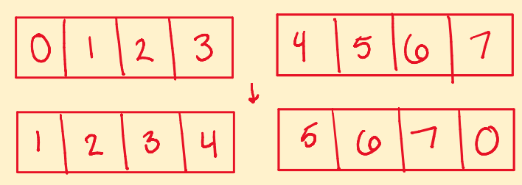
04: test_rotate_by_1_8xfloat
v
0
1
2
3
4
5
6
7
v
0
1
2
3
4
5
6
7
Input (a)
Output (b)
0
1
2
3
4
5
6
7

Slide 29
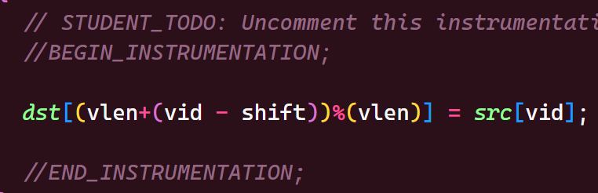
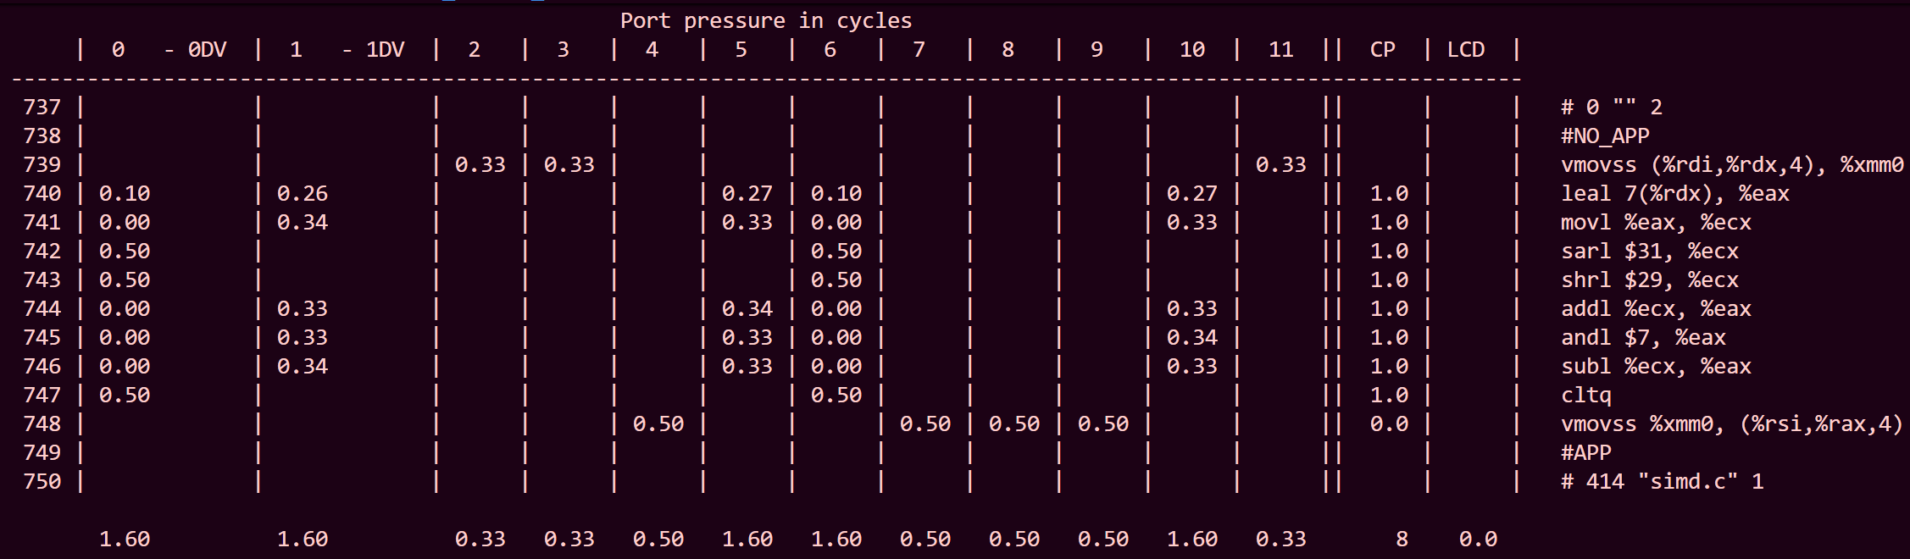
04: test_rotate_by_1_8xfloat: OSACA reference
Instrumented Reference Code
Each iteration copies one element of src to its rotated location in dst, shifted by 1 position.
The iteration is translated into 10 assembly instructions: vmovss, leal, movl, sarl, shrl, addl, andl, subl, cltq.
Critical path is 8 cycles.
There is no LCD.
The bottleneck is on ports 0, 1, 5, 6, and 10 for 1.6 cycles.
An iteration of this loop will complete every 1.6 cycles.
This loop can complete 1/1.6 = 0.625 iterations every cycle.
OSACA Report

Slide 30
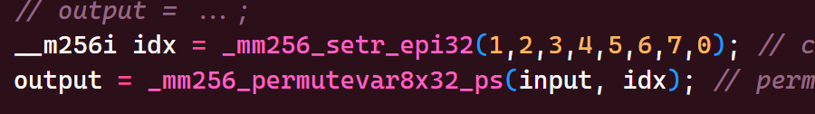
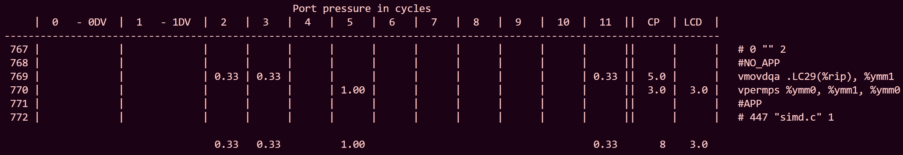
04: test_rotate_by_1_8xfloat: OSACA student
Instrumented Student Code
Each operation rotates all 8 elements of src by 1 position to their new locations in dst.
The iteration is translated into 2 assembly instructions: vmovdqa, vpermps.
Critical path is 8 cycles.
There is a 3 cycle LCD.
The bottleneck is on port 5 for 1 cycle.
An iteration of this loop will complete every 3 cycles.
This loop can complete 1/3 = 0.33 iterations every cycle.
OSACA Report

Slide 31
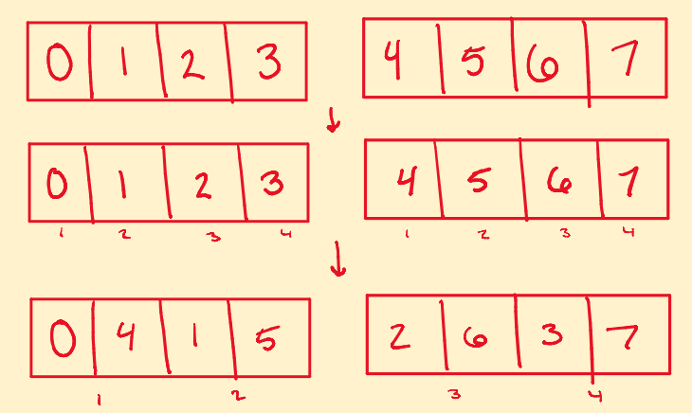
05: test_transpose_4x2_colmaj_8xfloat
v
0
1
2
3
4
5
6
7
v
0
1
2
3
4
5
6
7
Input (a)
Output (b)
0
1
2
3
4
5
6
7

Slide 32
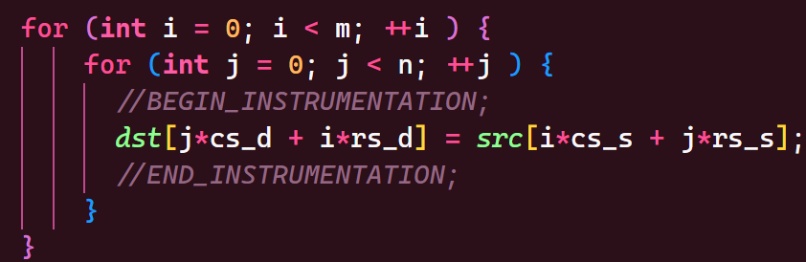
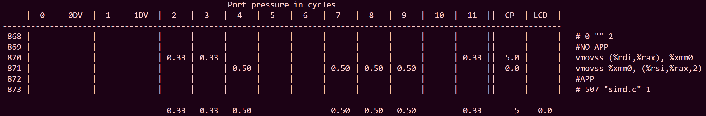
05: test_transpose_4x2_colmaj_8xfloat OSACA reference
Instrumented Reference Code
Each iteration copies one element from src to its transposed location in dst based on column-major indices.
The iteration is translated into 2 assembly instructions: vmovss.
Critical path is 5 cycles.
There is no LCD.
The bottleneck is on ports 4, 7, 8, and 9 for 0.5 cycles.
An iteration of this loop will complete every 0.5 cycles.
This loop can complete 1/0.5 = 2 iterations every cycle.
OSACA Report

Slide 33
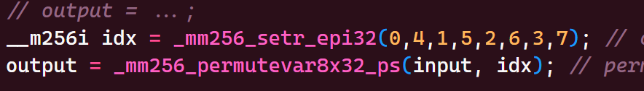
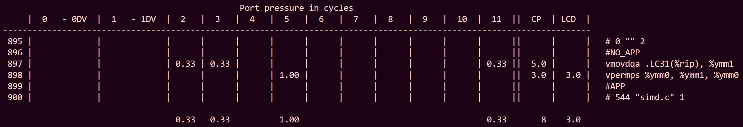
05: test_transpose_4x2_colmaj_8xfloat OSACA student
Instrumented Student Code
Each operation transposes all 8 elements of src to their new locations in dst for a 4x2 matrix.
The iteration is translated into 2 assembly instructions: vmovdqa, vpermps.
Critical path is 8 cycles.
There is a 3 cycle LCD.
The bottleneck is on port 5 for 1 cycle.
An iteration of this loop will complete every 3 cycles.
This loop can complete 1/3 = 0.33 iterations every cycle.
OSACA Report

Slide 34
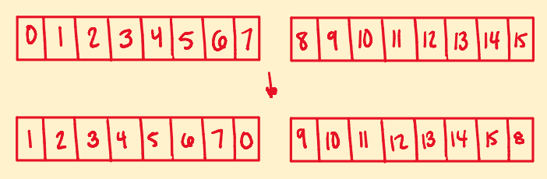
06: test_rotate_by_1_16xfloat
v
0
1
2
3
4
5
6
7
v
0
1
2
3
4
5
6
7
Input
(a[0:8], a[8:16])
Output
(b[0:8],b[8,16])
0
8
1
9
1
9
2
10
2
10
3
11
3
11
4
12
4
12
5
13
5
13
6
14
6
14
7
15
7
15
8
0

Slide 35
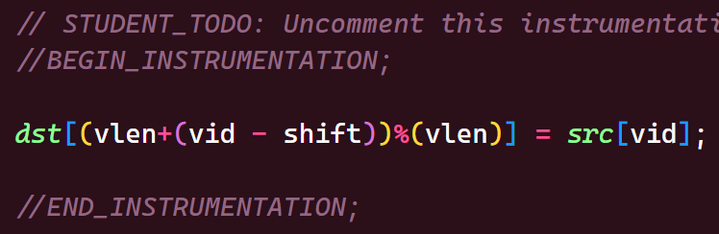
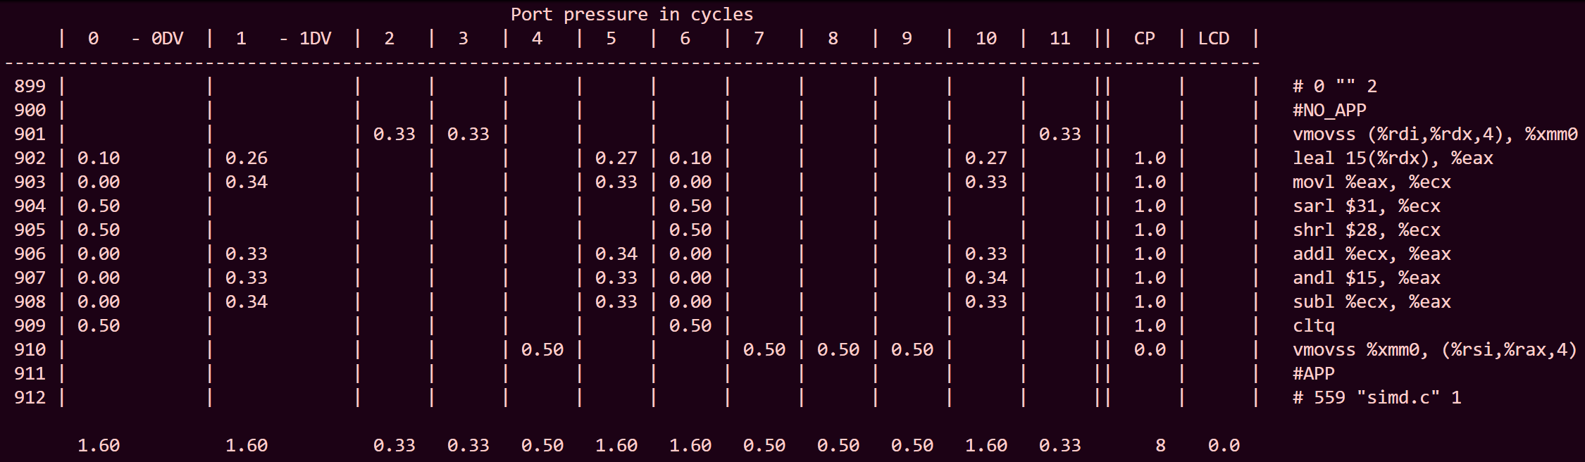
06: test_rotate_by_1_16xfloat: OSACA Ref
Instrumented Reference Code
Each iteration copies one element of src to its rotated location in dst, shifted by 1 position.
The iteration is translated into 10 assembly instructions: vmovss, leal, movl, sarl, shrl, addl, andl, subl, cltq.
Critical path is 8 cycles.
There is no LCD.
The bottleneck is on ports 0, 1, 5, 6, and 10 for 1.6 cycles.
An iteration of this loop will complete every 1.6 cycles.
This loop can complete 1/1.6 = 0.625 iterations every cycle.
OSACA Report

Slide 36


06: test_rotate_by_1_16xfloat: OSACA student
Instrumented Student Code
Each operation rotates all 16 elements of src by 1 position to their new locations in dst across two 256-bit vectors.
The iteration is translated into 9 assembly instructions: vblendps, vmovdqa, vpermps.
Critical path is 11 cycles.
There is a 6 cycle LCD.
The bottleneck is on port 5 for 4 cycles.
An iteration of this loop will complete every 6 cycles.
This loop can complete 1/6 = 0.167 iterations every cycle.
OSACA Report

Slide 37

07: test_transpose_4x4_colmaj_8xfloat:
v
0
1
2
3
4
5
6
7
v
0
1
2
3
4
5
6
7
Input
(a[0:8], a[8:16])
Output
(b[0:8],b[8,16])
0
8
0
2
1
9
4
6
2
10
8
10
3
11
12
14
4
12
1
3
5
13
5
7
6
14
9
11
7
15
13
15

Slide 38


07: test_transpose_4x4_colmaj_8xfloat: OSACA ref
Instrumented Reference Code
Each iteration copies one element from src to its transposed location in dst based on column-major indices.
The iteration is translated into 2 assembly instructions: vmovss.
Critical path is 5 cycles.
There is no LCD.
The bottleneck is on ports 4, 7, 8, and 9 for 0.5 cycles.
An iteration of this loop will complete every 0.5 cycles.
This loop can complete 1/0.5 = 2 iterations every cycle.
OSACA Report

Slide 39


07: test_transpose_4x4_colmaj_8xfloat: OSACA Student
Instrumented Student Code
Each operation transposes all 16 elements of src to their new locations in dst for a 4x4 matrix.
The iteration is translated into 14 assembly instructions: vmovaps, vextractf128, vunpcklps, vunpckhps, vmovlhps, vmovhlps, vinsertf128.
Critical path is 4 cycles.
There is a 4 cycle LCD.
The bottleneck is on port 5 for 8 cycles.
An iteration of this loop will complete every 8 cycles.
This loop can complete 1/8 = 0.125 iterations every cycle.
OSACA Report

Slide 40

08: test_transpose_8x4_colmaj_8xfloat:
v
0
1
2
3
4
5
6
7
v
0
1
2
3
4
5
6
7
Input
(a[0:8], a[8:16],a[16:24],a[24:32])
Output
(b[0:8],b[8,16], b[16:24],b[24,32])
0
8
16
24
6
0
2
4
1
9
17
25
10
12
14
8
2
10
18
26
18
20
22
16
3
11
19
27
26
28
30
24
4
12
20
28
3
5
7
1
5
13
21
29
11
13
15
9
6
14
22
30
19
21
23
17
7
15
23
31
25
27
29
31

Slide 41


08: test_transpose_8x4_colmaj_8xfloat: OSACA ref
Instrumented Reference Code
Each iteration copies one element from src to its transposed location in dst based on column-major indices.
The iteration is translated into 2 assembly instructions: vmovss.
Critical path is 5 cycles.
There is no LCD.
The bottleneck is on ports 4, 7, 8, and 9 for 0.5 cycles.
An iteration of this loop will complete every 0.5 cycles.
This loop can complete 1/0.5 = 2 iterations every cycle.
OSACA Report

Slide 42


08: test_transpose_8x4_colmaj_8xfloat: OSACA student
Instrumented Student Code
Each operation transposes all 32 elements of src to their new locations in dst for an 8x4 matrix.
The iteration is translated into 13 assembly instructions: vunpcklps, vunpckhps, vinsertf128, vperm2f128, vmovdqa, mpermps.
Critical path is 8 cycles.
There is a 7 cycle LCD.
The bottleneck is on port 5 for 12 cycles.
An iteration of this loop will complete every 12 cycles.
This loop can complete 1/12 = 0.083 iterations every cycle.
OSACA Report

Slide 43

09: test_gather_at_stride_8xfloat:
v
0
1
2
3
4
5
6
7
v
0
1
2
3
4
5
6
7
Input
(a[0:8], a[8:16],a[16:24],a[24:32])
Output
(b[0:8]])
0
8
16
24
0
1
9
17
25
4
2
10
18
26
8
3
11
19
27
12
4
12
20
28
16
5
13
21
29
20
6
14
22
30
24
7
15
23
31
28

Slide 44


09: test_gather_at_stride_8xfloat: OSACA ref
Instrumented Reference Code
Each iteration gathers one element from src at an index offset by the stride and stores it in dst.
The iteration is translated into 2 assembly instructions: vmovss.
Critical path is 5 cycles.
There is no LCD.
The bottleneck is on ports 4, 7, 8, and 9 for 0.5 cycles.
An iteration of this loop will complete every 0.5 cycles.
This loop can complete 1/0.5 = 2 iterations every cycle.
OSACA Report

Slide 45


09: test_gather_at_stride_8xfloat: OSACA student
Instrumented Student Code
Each operation gathers all 8 elements from src at stride 4 indices into dst.
The iteration is translated into 4 assembly instructions: vxorps, vcmpps, vmovdqa, vgatherdps.
Critical path is 23 cycles.
There is no LCD.
The bottleneck is on ports 2, 3, and 11 for 3.33 cycles.
An iteration of this loop will complete every 3.33 cycles.
This loop can complete 1/3.33 = 0.3003 iterations every cycle.
OSACA Report

Slide 46

10: test_scatter_at_stride_8xfloat:
v
0
1
2
3
4
5
6
7
Input
(a[0:8])
v
0
1
2
3
4
5
6
7
Output
(b[0:8],b[8,16], b[16:24],b[24,32])
0
0
2
4
6
1
x
x
x
x
2
x
x
x
x
3
x
x
x
x
4
1
3
5
7
5
x
x
x
x
6
x
x
x
x
7
x
x
x
x

Slide 47


10: test_scatter_at_stride_8xfloat: OSACA ref
Instrumented Reference Code
Each iteration scatters one element from src to dst at an index offset by the stride.
The iteration is translated into 2 assembly instructions: vmovss.
Critical path is 5 cycles.
There is no LCD.
The bottleneck is on ports 4, 7, 8, and 9 for 0.5 cycles.
An iteration of this loop will complete every 0.5 cycles.
This loop can complete 1/0.5 = 2 iterations every cycle.
OSACA Report

Slide 48


10: test_scatter_at_stride_8xfloat: OSACA student
Instrumented Student Code
Each operation scatters all 8 elements of src to their stride 4 offset locations in dst across four 256-bit vectors.
The iteration is translated into 13 assembly instructions: vmovdqa, vpermps, broadcastss, vblendps.
Critical path is 8 cycles.
There is a 3 cycle LCD.
The bottleneck is on port 5 for 4 cycles.
An iteration of this loop will complete every 4 cycles.
This loop can complete 1/4 = 0.25 iterations every cycle.
OSACA Report

Slide 49


11: test_matvec_8x8_colmaj_8xfloat:
Input
Output

Slide 50


11: test_matvec_8x8_colmaj_8xfloat: OSACA ref
Instrumented Reference Code
Each iteration accumulates the product of one element from A and x into the corresponding element of y.
The iteration is translated into 4 assembly instructions: vmovss, vmulss, vaddss.
Critical path is 12 cycles.
There is a 3 cycle LCD.
The bottleneck is on ports 2, 3, and 11 for 1 cycle.
An iteration of this loop will complete every 3 cycles.
This loop can complete 1/3 = 0.33 iterations every cycle.
OSACA Report

Slide 51


11: test_matvec_8x8_colmaj_8xfloat: OSACA student
Instrumented Student Code
Each operation accumulates the dot product of all 8 rows of A with the corresponding elements of x into y using fused multiply-add operations.
The iteration is translated into 17 assembly instructions: vbroadcastss, vxorps, vfmadd132ps.
Critical path is 37 cycles.
There is a 4 cycle LCD.
The bottleneck is on ports 0 and 1 for 4 cycles.
An iteration of this loop will complete every 4 cycles.
This loop can complete 1/4 = 0.25 iterations every cycle.
OSACA Report

Slide 52
Assets
Feel free to modify and use these.

Slide 53
Use these vectors as shapes for your diagrams
0
8
16
24
32
40
48
56
1
9
17
25
33
41
49
57
2
10
18
26
34
42
50
58
3
11
19
27
35
43
51
59
4
12
20
28
36
44
52
60
5
13
21
29
37
45
53
61
6
14
22
30
38
46
54
62
7
15
23
31
39
47
55
63

Slide 54








Or these vectors as pictures (you can scale these)

Slide 55
Load
Memory:
buff[]
Vector Register:
vect
0
1
2
3
4
5
6
7
.
.
a
a
__m256 vect = _mm256_load_ps(&buff[0]);
b
b
c
c
d
d
e
e
f
f
g
g
h
h

Slide 56
Store
Vector Register:
vect
Memory:
buff[]
a
0
1
2
3
4
5
6
7
.
.
a
_mm256_store_ps(&buff[0],vect );
b
b
c
c
d
d
e
e
f
f
g
g
h
h

Slide 57
Set1
Vector Register:
vect
a
__m256 vect = _mm256_set1_ps(a);
a
constant
a
a
a
a
a
a
a

Slide 58
Permute Across Lanes Example
Vector Register:
index avect
Vector Register:
bvect
5
a
f
__m256i index = _mm256_set_epi32(1,3,2,4,7,0,6,5);
__m256 bvect = _mm256_permutevar8x32_ps(avect,index);
6
b
g
0
c
a
7
d
h
4
e
e
2
f
c
3
g
d
1
h
b

Slide 59
Shuffle
Vector Register:
avect bvect
Vector Register:
cvect
a
i
c
int imm = 0b01001110;
__m256 cvect = _mm256_shuffle_ps(avect,bvect,imm);
b
j
d
c
k
i
DEFINE SELECT4(src, control) { CASE(control[1:0]) OF
0: tmp[31:0] := src[31:0]
1: tmp[31:0] := src[63:32]
2: tmp[31:0] := src[95:64]
3: tmp[31:0] := src[127:96]
ESAC RETURN tmp[31:0] }
dst[31:0] := SELECT4(a[127:0], imm8[1:0]) dst[63:32] := SELECT4(a[127:0], imm8[3:2]) dst[95:64] := SELECT4(b[127:0], imm8[5:4]) dst[127:96] := SELECT4(b[127:0], imm8[7:6]) dst[159:128] := SELECT4(a[255:128], imm8[1:0]) dst[191:160] := SELECT4(a[255:128], imm8[3:2]) dst[223:192] := SELECT4(b[255:128], imm8[5:4]) dst[255:224] := SELECT4(b[255:128], imm8[7:6]) dst[MAX:256] := 0
d
l
j
e
m
g
f
n
h
g
o
m
h
p
n

Slide 60
Extract
Vector Register:
vect
Memory:
buff[]
a
0
1
2
3
4
5
6
7
.
.
a
buff[0] = _mm256_cvtss_f32(vect);
b
c
d
e
f
g
h

Slide 61
Blend
Vector Register:
avect bvect
Vector Register:
cvect
a
i
a
int imm = 0b01001110;
__m256 cvect = _mm256_blend_ps(avect,bvect,imm);
b
j
j
c
k
k
FOR j := 0 to 7
i := j*32
IF imm8[j]
dst[i+31:i] := b[i+31:i]
ELSE
dst[i+31:i] := a[i+31:i]
FI
ENDFOR
d
l
l
e
m
e
f
n
f
g
o
o
h
p
h

Slide 62
Fused Multiply and Add (FMADD)
Vector Register:
avect bvect cvect
Vector Register:
dvect
a0
b0
c0
a0*b0+c0
a1
b1
c1
a1*b1+c1
a2
b2
c2
a2*b2+c2
a3
b3
c3
a3*b3+c3
a4
b4
c4
a4*b4+c4
a5
b5
c5
a5*b5+c5
a6
b6
c6
a6*b6+c6
a7
b7
c7
a7*b7+c7
__m256 dvect = _mm256_fmadd_ps(avect,bvect,cvect );

Slide 63

SIMD Vectorization
https://software.intel.com/content/www/us/en/develop/articles/3d-vector-normalization-using-256-bit-intel-advanced-vector-extensions-intel-avx.html
SEE: https://www.cs.virginia.edu/~cr4bd/3330/F2018/simdref.html

